Slide 1

A 100-YEAR PLAN TO FIX THE PROBLEM OF SUFFERING
Towards a Hyperthymic Civilization.
An Action Plan to Eradicate Suffering in Humans and Non-human Animals
by David Pearce
dave@hedweb.com
hedweb.com
Compassionate Future Summit
21–25 August 2025, Berlin

Slide 2

ACTION PLAN: INTRODUCTION: THE VISION
The Moral Imperative
Why Suffering Must End
Suffering has no intrinsic value and serves no essential purpose for advanced civilizations.
Every sentient being deserves freedom from involuntary pain and distress.
Technology and genome reform make the abolition of suffering technically feasible.
Moral progress demands we extend our circle of compassion to all sentient life.
Hyperthymia: a baseline of robust happiness, resilience, and motivation.

Slide 3
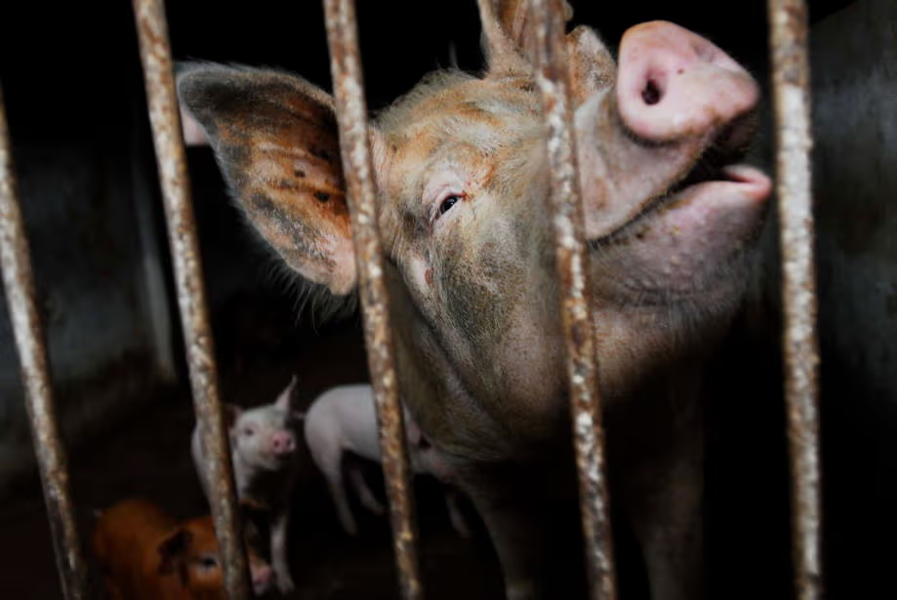
ACTION PLAN: INTRODUCTION (cont.)
THE CURRENT LANDSCAPE OF DARWINIAN LIFE
The Scale of Suffering Today
Billions of humans experience depression, anxiety, chronic pain, and distress.
Trillions of non-human animals suffer in factory farms, laboratories, and the wild.
Mental illness affects around 1 in 4 people globally.
Traditional approaches offer only partial, temporary relief.

Slide 4

ACTION PLAN: INTRODUCTION (cont.)
TOWARDS A MORE CIVILIZED SIGNALLING-SYSTEM
A Darwinian Pleasure-Pain Axis versus a Post-Darwinian Pleasure-Superpleasure Axis
"Health is a state of complete physical, mental and social well-being"
(World Health Organization Constitution, 1948)
versus
Information-sensitive gradients of well-being

Slide 5

ACTION PLAN: INTRODUCTION (cont.)
Core Strategy of Hedonic Uplift — The Hedonistic Imperative
Genetically recalibrate hedonic set-points.
Replace pain and suffering with information-sensitive gradients of well-being.
Preserve intelligence, critical thinking, social responsibility.
Avoid wireheading and maintain motivational structures.

Slide 6

ACTION PLAN: INTRODUCTION (cont.)
BRANDING: Remediation versus enhancement
Transhumanists: Superintelligence, Superlongevity, Superhappiness
vs
Bioconservatives: Good Health For All

Slide 7

THE REPRODUCTIVE REVOLUTION
ACTION PLAN «FOR PROSPECTIVE PARENTS»
Offer universal access to polygenic embryo screening and genome editing for high hedonic range, high hedonic set-points and strong pain-tolerance
Goal: a hyperthymic civilization underpinned by gradients of intelligent bliss
Nociception without significant pain (cf. rare genetic outliers today for whom "Pain is just a useful signalling mechanism!")

Slide 8

THE GOOD GENE GUIDE
Future children should have only benign alleles of the SCN9A ("the volume knob for pain") and the DRD2, DAT1, COMT, OPRM1, CNR1 and FAAH genes.
The genes most directly involved in baseline hedonic tone are the dopamine–opioid–endocannabinoid triad:
DRD2, DAT1, COMT, OPRM1, CNR1, FAAH.
The serotonin system (SLC6A4, HTR1A/2A, TPH2) and stress genes (CRHR1, FKBP5) modulate hedonic tone, but are more context-sensitive.
BDNF/CREB genes regulate plasticity of hedonic set-points.
https://www.gradients.com
https://www.biohappiness.com

Slide 9

ACTION PLAN «FOR EXISTING HUMANS»
INTRAVENOUS SOMATIC GENE THERAPY FOR HEDONIC UPLIFT, EPIGENETIC EDITING AND LIFESPAN HEDONICS
Advances in autosomal gene therapy and epigenetic editing promise heritable regulation of hedonic tone and the stress-response systems, allowing elevated hedonic set-points across the lifespan.
https://www.hedweb.com/social-media/beyond-humanism.pdf

Slide 10

FINANCING
Around 280 million people worldwide — approximately 5% of the total human population - live with depression.
Hundreds of millions of people are sub-clinically depressed.
Trillions of dollars in lost output.
Happier, depression-resistant people are more economically productive.
The Reproductive Revolution will pay for itself many times over.

Slide 11
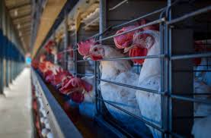
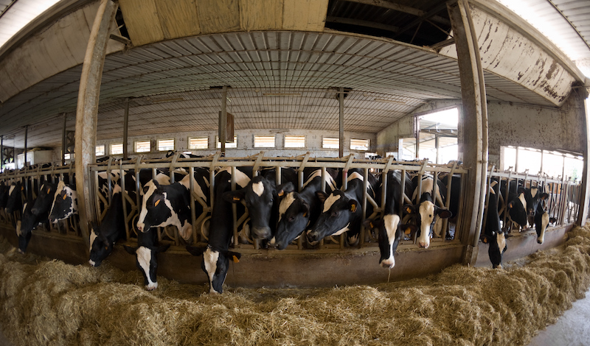
NON-HUMAN ANIMALS
An End To Animal Agriculture
The Weak Link: Slaughterhouses
ACTION: Animal advocacy AND lobbying for legislation to close all slaughterhouses by 2040? 2035?
Delayed Implementation: morally obscene, politically necessary.

Slide 12

Cultured Meat and Farm-Free Animal Products
Key educational message: cultured meat is genetically "natural", not genetically engineered.
(Future cultured meat products could be genetically enhanced for improved texture, taste, nutritional profile, etc.
BUT politically toxic)
Contrast the "unnatural" selective breeding and genetic manipulation of factory-farmed non-human animals, routine antibiotic use, artificial feed additives and supplementation, use of growth hormones, confinement and suppression of natural behaviours, overall reduced nutritional profile.
BRANDING
Cruelty-free cultured meat - "naturally inspired"
Cruel, factory-farmed meat - "unnatural"
Cultured Meat

Slide 13

WILD ANIMAL SUFFERING
ACTION:
PILOT STUDY
The World's First Cruelty-Free Artificial Biosphere
FEATURES: hedonic uplift, pain suppression, population control via cross-species fertility regulation (immunocontraception and tunable CRISPR-based synthetic gene drives) instead of predation and starvation.

Slide 14
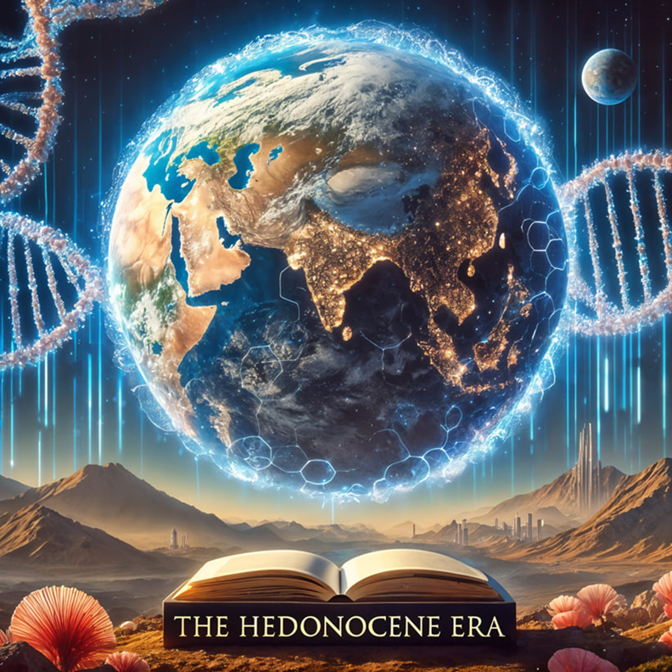
THE FUTURE OF SENTIENCE
PARADISE ENGINEERING, A BIOHAPPINESS REVOLUTION AND A PAN-SPECIES WELFARE STATE
The exponential growth of computer power means every cubic metre of the biosphere will shortly be accessible to benevolent surveillance and compassionate micromanagement.
AI, nanotech, robotics, herbivorizing predators, CRISPR genome-editing and synthetic gene drives turn the level of suffering in the biosphere into an adjustable parameter.
gene-drives.com
reprogramming-predators.com

Slide 15

AI ALIGNMENT WITH THE ABOLITIONIST PROJECT
Machine (super)intelligence should promote the well-being of all sentience in our forward light-cone.
AI systems must be designed to recognize, measure, and optimize sentient well-being as their primary goal.
https://www.hedweb.com/ai-for-animals/darwinian-hellworlds-and-cosmic-rescue-missions.pdf

Slide 16
Towards the abolition of suffering through science.
David Pearce
dave@hedweb.com
hedweb.com
THE END

