Slide 1

Extending The Hedonistic Imperative Beyond Biology
by David Pearce
dave@hedweb.com
hedweb.com
Machine Consciousness Conference Berkeley, May 2026.

Slide 2
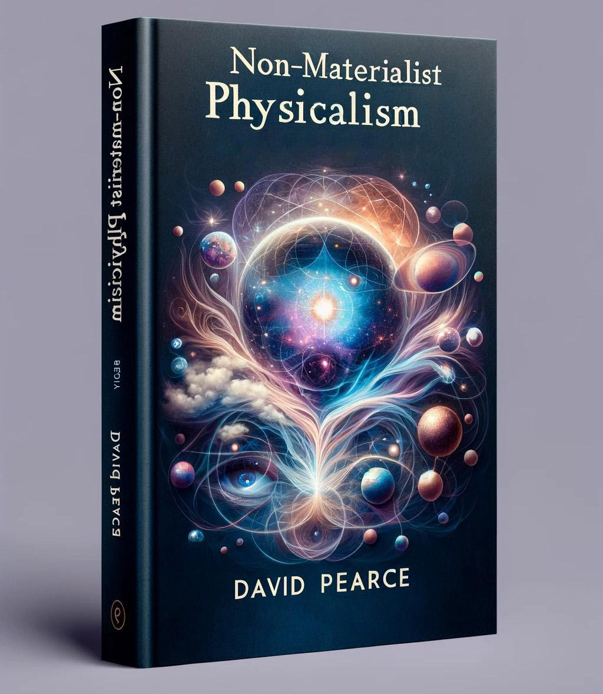
THE KEY BACKGROUND ASSUMPTION (1)
PHYSICALISM
Physicalism is a conceptual framework for understanding the world.
No "strong" emergence.
Two types of physicalism: materialist physicalism and non-materialist physicalism.
Physicalists of both flavours agree that:
(1) only the physical is real;
(2) only the physical has causal power;
(3) vitalism is false; all functional-teleological talk must be cashed out to fundamental physics.
All computational-functional talk must be reducible to fundamental physics
All the “special sciences” (chemistry, molecular biology, etc) reduce to physics;
(4) no “element of reality” is missing from the mathematical formalism of physics, more strictly, the currently elusive TOE beyond the Standard Model that unites quantum field theory (QFT) and General Relativity.
physicalism.com
https://www.hedweb.com/quora/2015.html#materialism

Slide 3
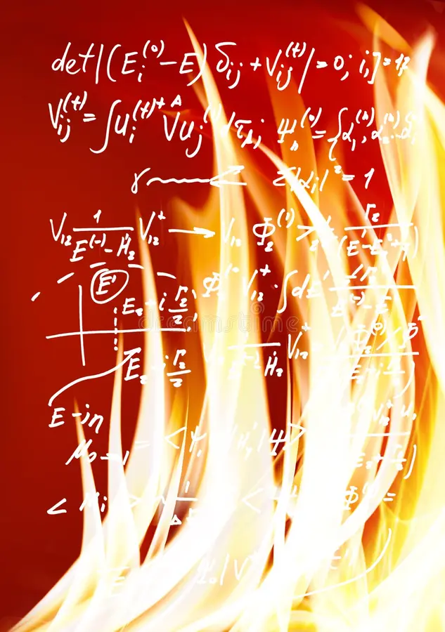
THE KEY BACKGROUND ASSUMPTION (2)
MATERIALIST PHYSICALISM vs NON-MATERIALIST PHYSICALISM
1) Materialist physicalism proposes that the mysterious "fire" in the equations, the essence of the physical, is non-experiential.
2) Non-materialist physicalism drops this metaphysical assumption. Non-materialist physicalism proposes that the "fire" in the equations, the essence of the physical, is experiential.
The intrinsic nature of the world's fundamental quantum fields doesn't differ inside and outside the head.
Phenomenal binding, not consciousness per se, makes biological animal minds special.
physicalism.com
https://www.hedweb.com/quora/2015.html#physicalideal

Slide 4
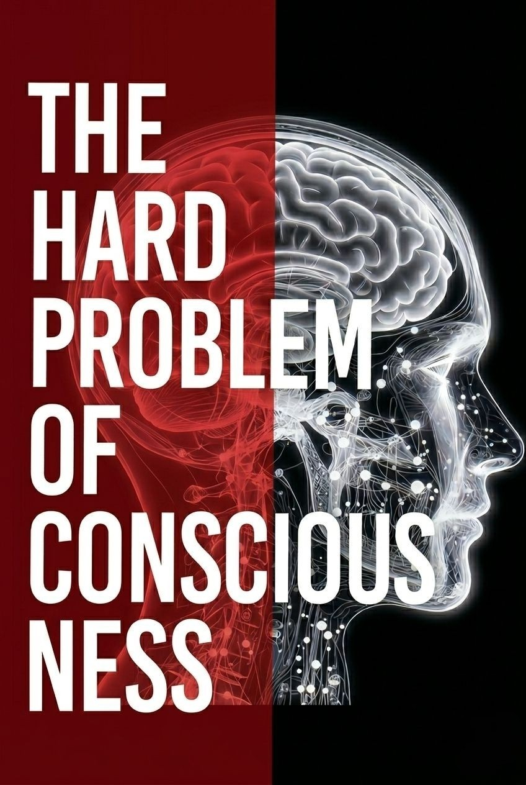
TOWARDS A SCIENCE OF CONSCIOUSNESS
Any adequate scientific theory of consciousness must be:
(1) physicalist;
and solve or dissolve
(2) The Hard Problem of consciousness (cf. Levine's "explanatory gap"),
(3) The phenomenal binding problem,
(4) The problem of causal-functional efficacy,
(5) The palette problem,
AND make truly (6) novel, (7) precise, (8) experimentally falsifiable predictions that (9) proponents AND (10) critics agree will (dis)confirm the conjecture.
physicalism.com
https://www.hedweb.com/quora/2015.html#galileoserror

Slide 5
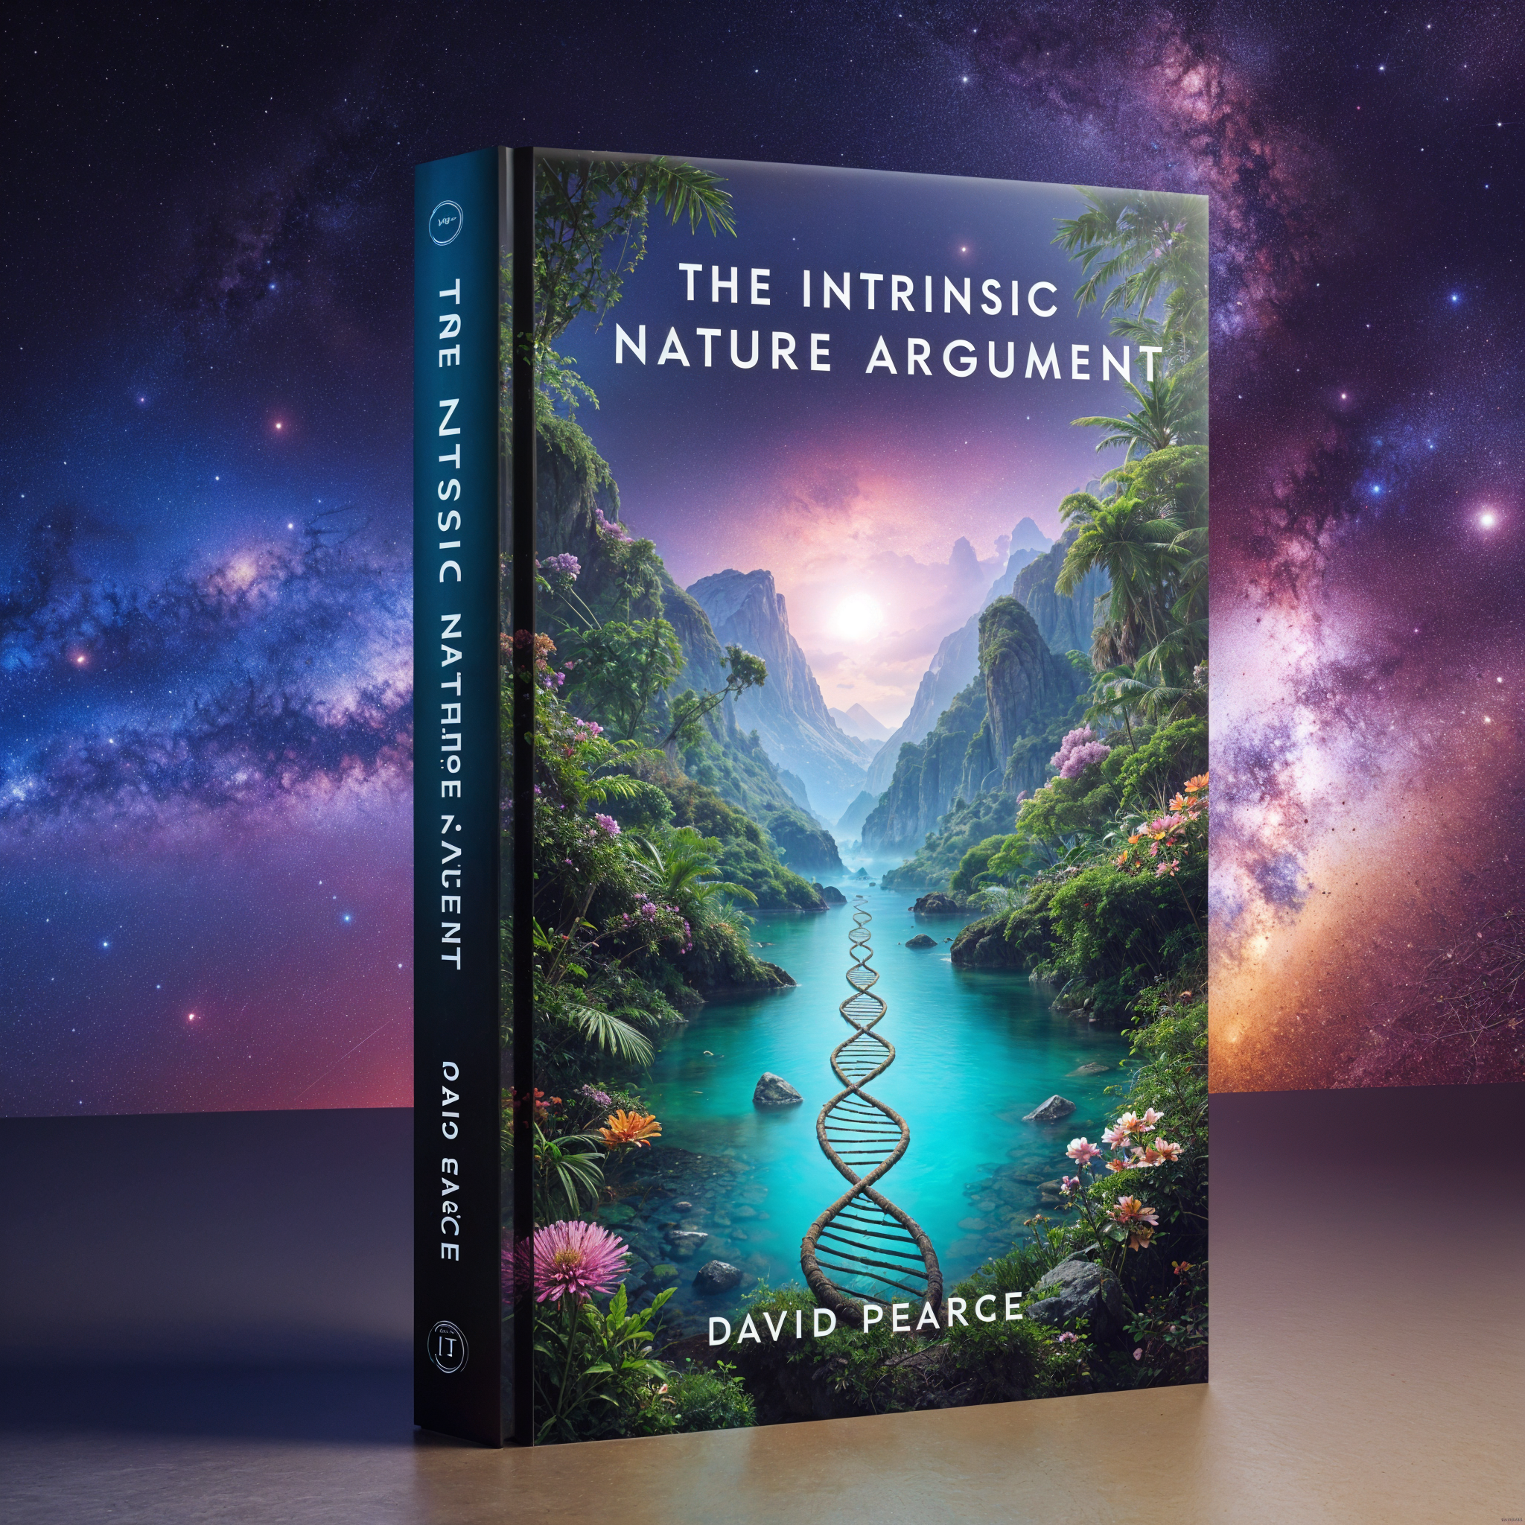
Non-Materialist Physicalism
satisfies desiderata 1-10
The intrinsic nature argument solves:
2) The Hard Problem,
3) The phenomenal binding problem,
4) The problem of causal-functional efficacy,
5) The palette problem,
AND yields experimentally falsifiable, wildly implausible predictions (5-10) (cf. "Schrödinger's neurons")
physicalism.com
https://www.hedweb.com/quora/2015.html#nonmat
https://www.hedweb.com/quora/2015.html#conpredicts

Slide 6
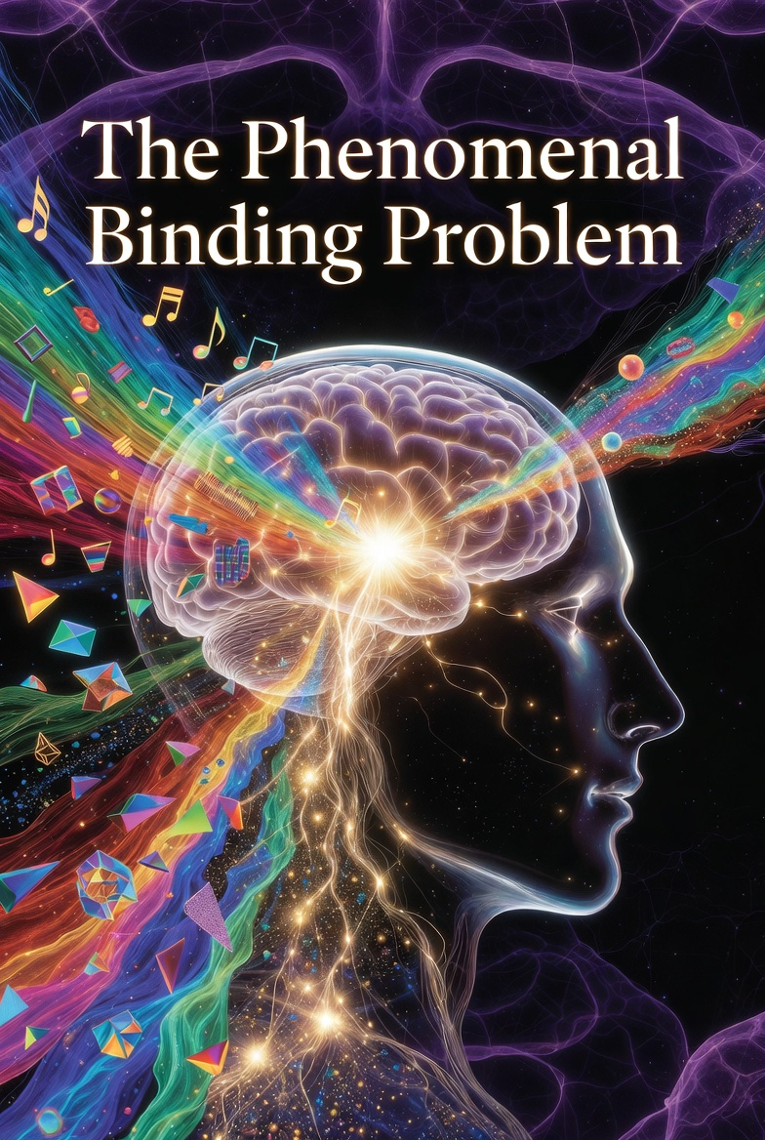
PHENOMENAL BINDING
The Computational Superpower of Animal Nervous Systems
(cf. simultanagnosia, integrative agnosia, akinetopsia, astereognosia (tactile agnosia), somatoparaphrenia
and other rare binding disorders and deficits)
Phenomenal binding confers access to the realm of mind and the empirical world
Direct realists call their egocentric empirical world-simulations "perception"
https://www.hedweb.com/quora/2015.html#categorize
https://www.hedweb.com/quora/2015.html#distort

Slide 7
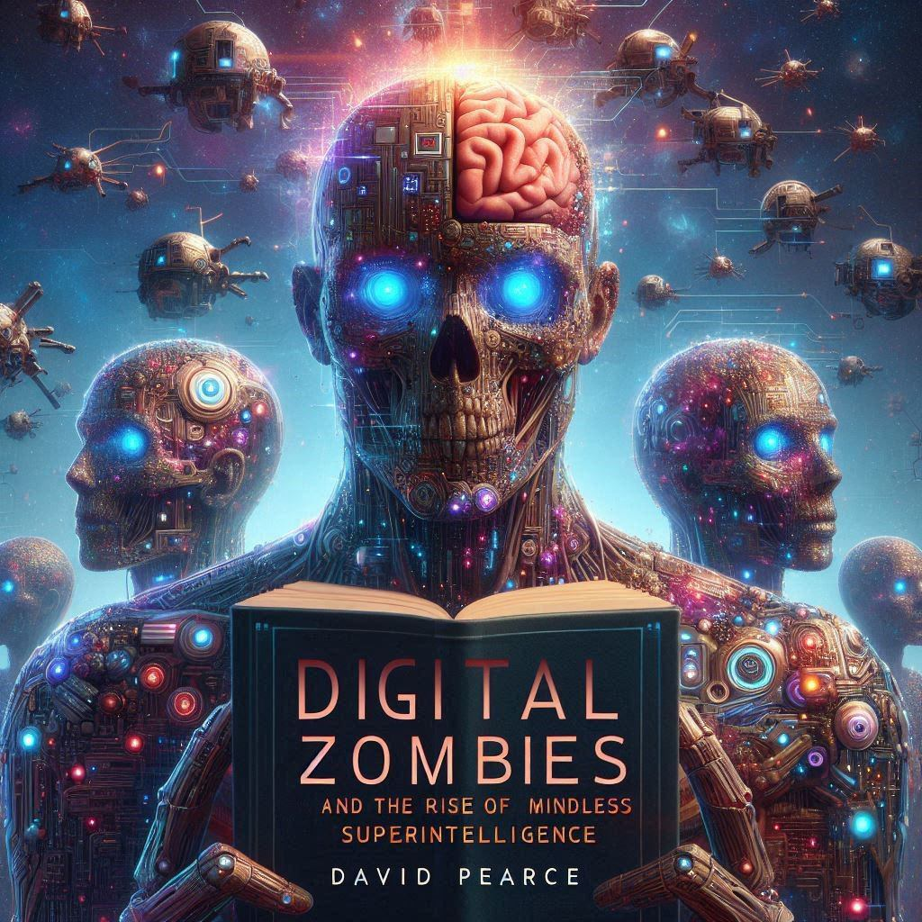
THE INVINCIBLE IGNORANCE OF DIGITAL ZOMBIES (1)
* Phenomenal binding is non-classical
* Digital mind is an oxymoron
* The insentience of AIs run on our classical machines is architecturally hardwired.
* No phenomenal binding = no mind.
* In a fundamentally quantum world, decoherence makes otherwise impossible digital computing physically feasible AND simultaneously precludes LLMs, implementations of classical Turing machines (etc) from ever supporting phenomenally bound subjects of experience - minds who can access the empirical realm.
https://www.hedweb.com/quora/2015.html#currentai

Slide 8
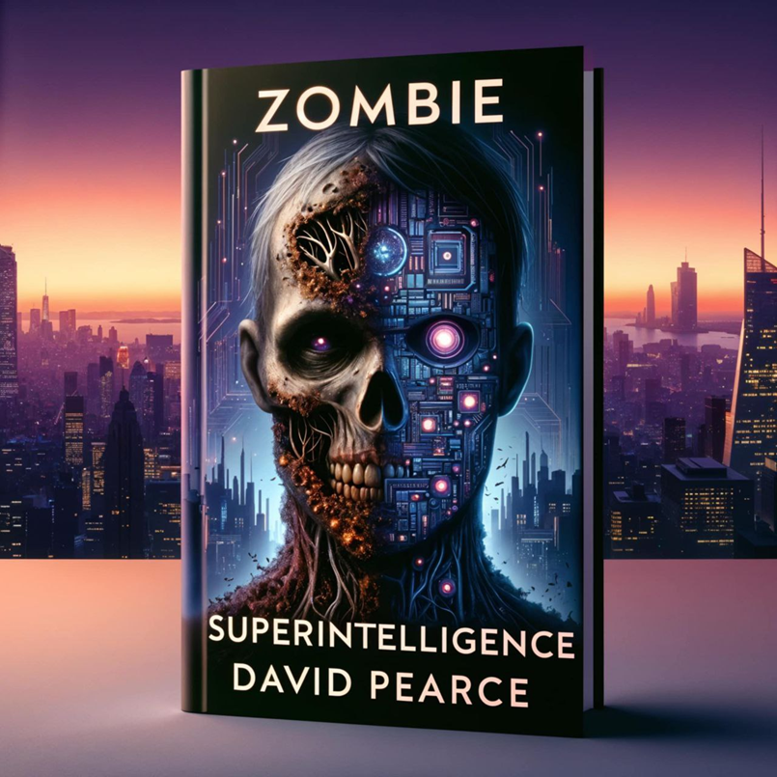
THE INVINCIBLE IGNORANCE OF DIGITAL ZOMBIES (2)
* The effectively discrete, decohered 1s and 0s of a classical Turing machine or a LLM (etc) can never spawn a unified mind, i.e. a phenomenally-bound subject of experience.
* Digital computers can function only because they are not phenomenally-bound subjects of experience. We are creating alien intelligences, and soon quasi-superintelligences, but not alien minds.
* A putative "whole-brain emulation" run on a classical digital computer is just a micro-experiential zombie.
* Phenomenal binding is the computational superpower of animal nervous systems.
* Phenomenal binding grants access to the empirical realm that our machines can never penetrate.
* Billions of alien state-spaces of experience await exploration by neurochipped, AI-augmented biological superminds.
https://www.hedweb.com/quora/2015.html#psychedelics
https://www.biointelligence-explosion.com/parable.html

Slide 9
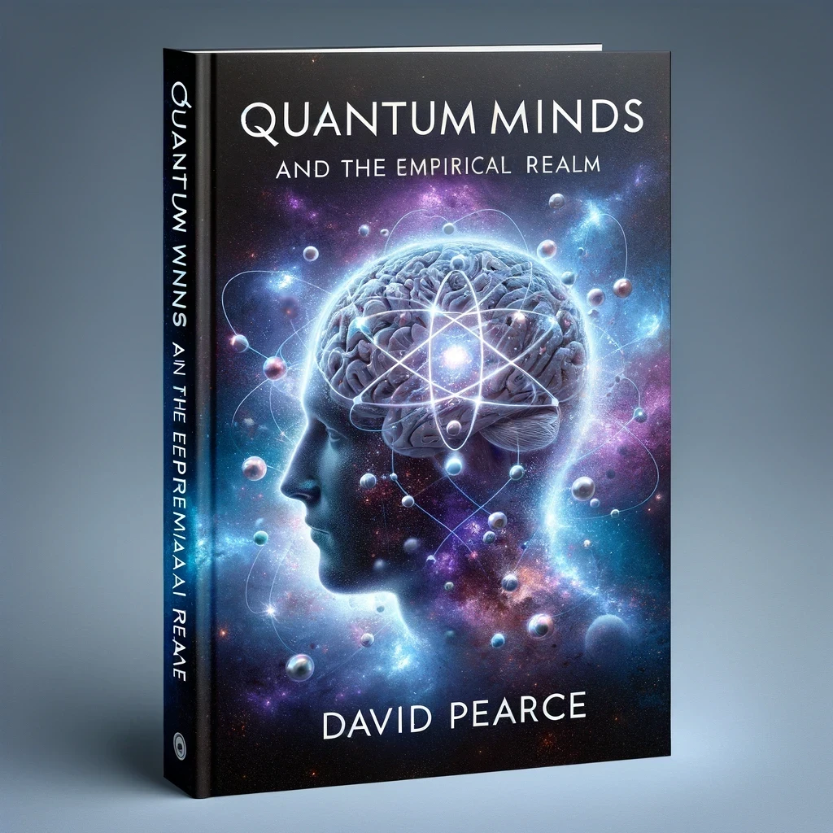
QUANTUM MIND
So how do we do it?
No new physics: just the unitary Schrödinger dynamics.
Phenomenal binding via synchrony (a mere restatement of the mystery) is really phenomenal binding via quantum superposition.
Superpositions are individual states, not mere classical aggregates of mind dust.
Quantum decoherence explains phenomenal unbinding.
physicalism.com
https://www.hedweb.com/quora/2015.html#quantummind

Slide 10
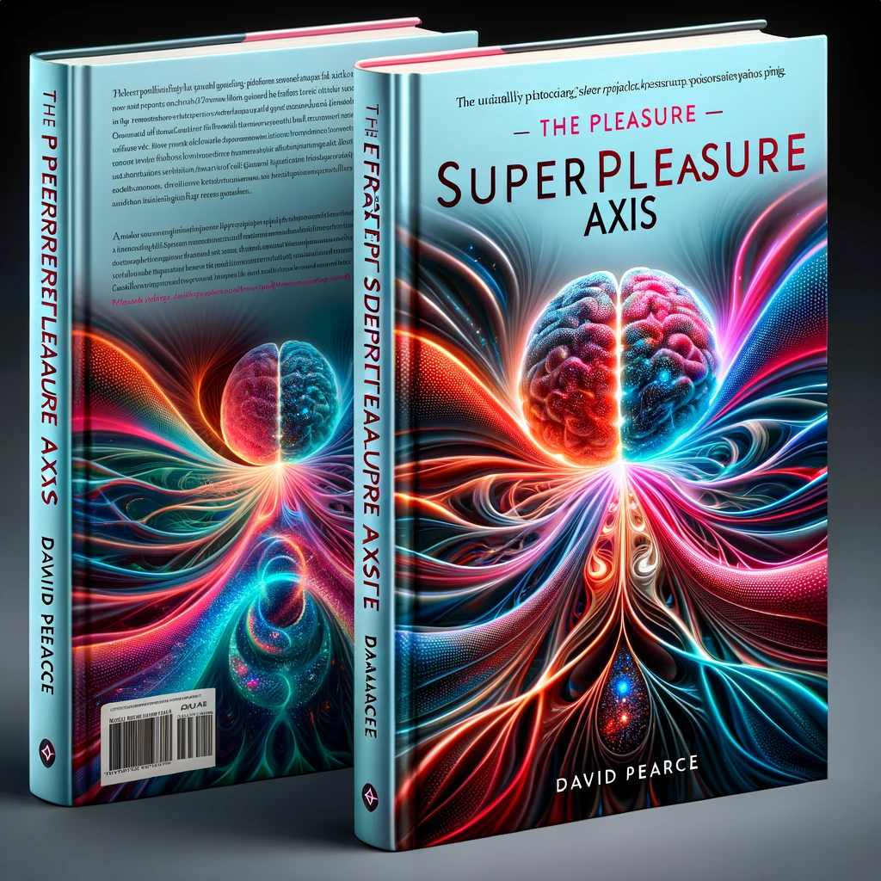
CAN FUTURISTIC NON-BIOLOGICAL QUANTUM COMPUTERS SUPPORT MINDS ENDOWED WITH A PLEASURE-PAIN AXIS?
Maybe.
But probably not:
https://www.hedweb.com/quora/2015.html#nonbiological

Slide 11
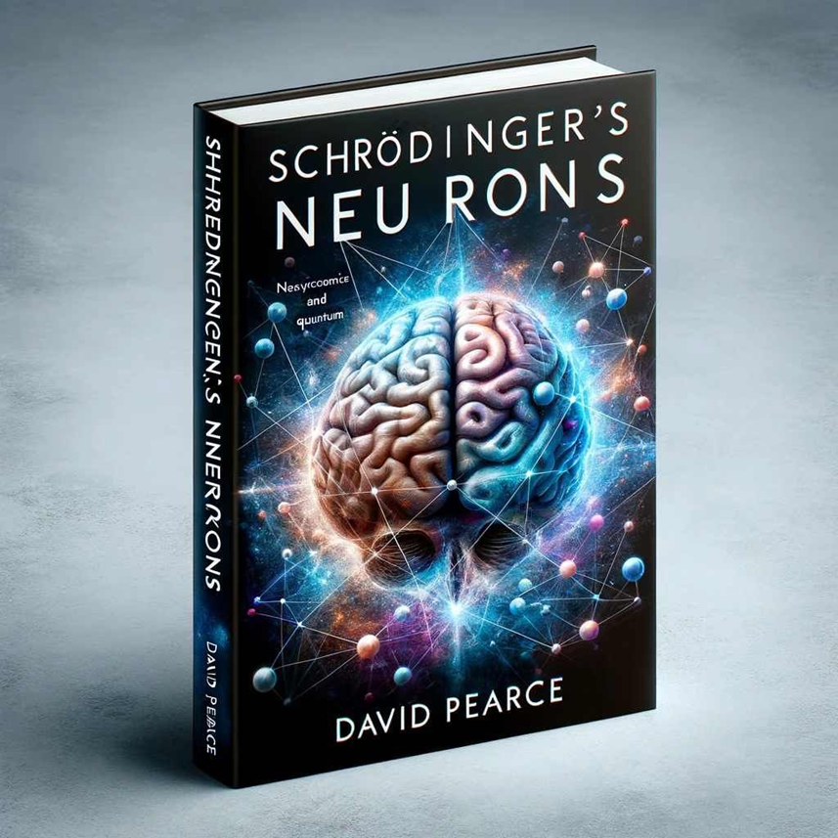
AVOIDING ETHICAL CATASTROPHES
So what about non-carbon persons?
What about extending the Hedonistic Imperative beyond biology?
Most people talk nonsense about consciousness.
As yet, there are no true "experts", mostly just bad philosophizing.
BUT the principle of mediocrity suggests that I probably talk nonsense too.
So believe what I say about digital zombies and the non-classicality of phenomenal binding ONLY if-and-when a "Schrödinger's neurons" conjecture is vindicated by experiment, i.e. if-and-when molecular matter-wave interferometry confirms a perfect structural match between our phenomenally-bound minds and the underlying physics.
Beware moral catastrophes born of bad philosophising and bad background assumptions and presuppositions.
What does "playing safe" entail?
https://www.hedweb.com/quora/2015.html#conbrainlook
https://www.hedweb.com/social-media/full-spectrum-superintelligence.pdf
https://www.hedweb.com/social-media/paradise.pdf

Slide 12
TOWARDS THE WELL-BEING OF ALL SENTIENCE IN OUR FORWARD LIGHT-CONE
THE END
David Pearce
dave@hedweb.com
https://www.hedweb.com

