Slide 1
NEUROETHICS FOUNDATION
CREATING
POST-DARWINIAN LIFE
Could two small genetic tweaks get rid of most of the world’s physical and mental pain?
DAVID PEARCE

Slide 3
Human Genetic Experimentation
Is it ethical to create children who will suffer a terrible genetic disease (aging), multiple intellectual handicaps, and terrible mental and physical pain?

Slide 4
Yes.
Life is wonderful!

Slide 5
TIME FOR A MORATORIUM ON RECKLESS GENETIC EXPERIMENTS?
Antinatalism won’t solve the problem of suffering. Staying child-free - or adopting - imposes selection pressure in favour of baby-making.

Slide 6
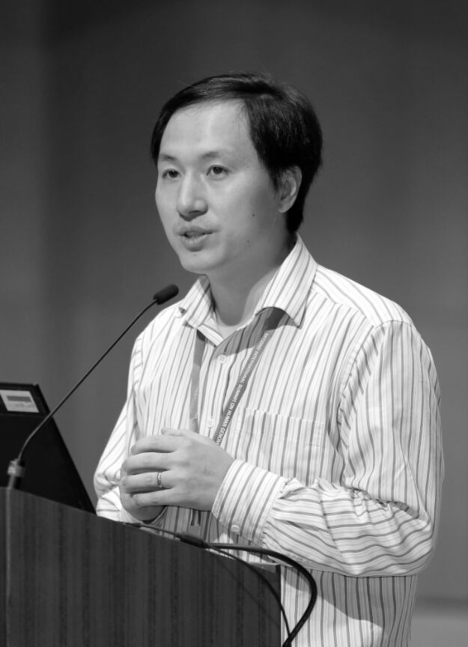
He Jiankui
Used CRISPR
gene-editing technology to tweak the DNA of human embryos during in vitro fertilization.
"This experiment is monstrous.”
(Julian Savulescu, Medical Ethicist, University of Oxford)

Slide 7
FAAH and the newly-discovered FAAH-out gene
Jo Cameron
72 year old vegan
Retired school teacher
Experiences almost no physical or mental pain
Childbirth "felt like a tickle"
Chronic mild euphoria
Information-sensitive gradients of well-being

Slide 8
Absence or underactivity of the FAAH gene is associated with reduced pain-sensation.
Accelerated wound-healing
Rapid extinction of fearful memories
Reduced anxiety
High hedonic set-point
Lifelong happy mood
Delayed aging
Anandamide increases neurogenesis
FAAH and FAAH-OUT genes
Fatty acid amide hydrolase
The FAAH enzyme breaks down anandamide (Sanskrit for "joy, bliss, or happiness")

Slide 9
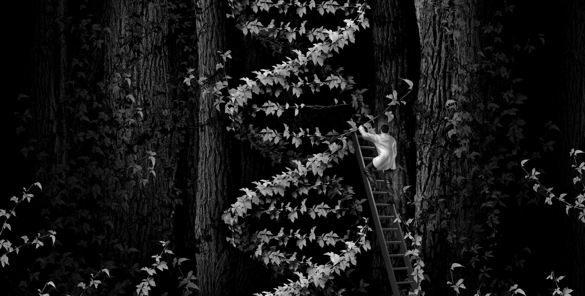
PROPOSAL
Large well-controlled clinical trials of CRISPR babies with FAAH and FAAH-OUT mutations.

Slide 10
GOAL
All prospective parents should be offered genetic screening, counselling and access to CRISPR genome-editing for happy, healthy babies.

Slide 11
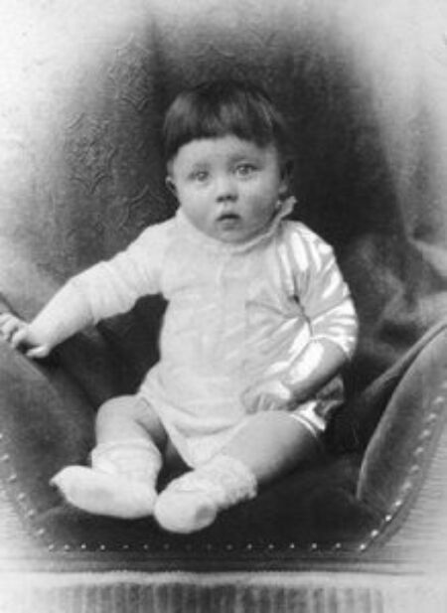
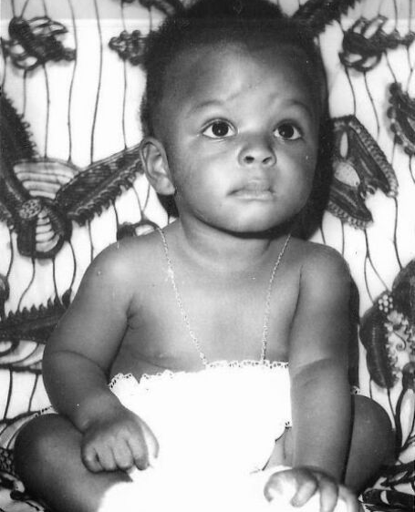
RISKS OF HUMAN GENETIC EXPERIMENTATION

Slide 12
TRANSHUMANISM
Towards a “Triple S” Civilisation of
Superhappiness, Superlongevity and Superintelligence
abolitionist.com
humanityplus.org
neuroethics.com

